Slide 1

Kuali Identity Management Overview
Notes:
TODO:
Add other diagrams
Need talking points for other slides
Flesh out the beginnings of KIM
Need to talk about Person
Add part about NS authZ interface - person is part of that

Slide 2


Why did we write KIM?
Common Interface for Kuali Applications
Provide a Fully-Functional Product
A Single API for:
  Identity Retrieval
  Group Retrieval
  Authentication
  Authorization
Notes:
1st priority - meet the needs of the existing Kuali family applications
APIs are pluggable - can be pointed to your own IdM systems
no single product (open/community source) that provides all these functions
didn't want smaller institutions to have to write integration code just to get it working
will be providing reference implementation of authN using Shib

Slide 3
KIM Features
Integrated APIs for Supporting:
  Authentication
  Authorization
  Roles
  Groups
Maintenance User Interfaces
Pluggable Architecture
  Sourcing identity data from external systems
  Accessing application data when using KIM implementation
Notes:
give example of organization code - KFS concept

Slide 4
KIM Concepts
Entities
Principals
Roles
Groups
Permissions
Responsibilities
Types/Attributes
Qualified Roles
Notes:
will go over each of these in turn

Slide 5
KIM Services
Six Core Services
  Identity Service
  Group Service
  Role Service
  Permission Service
  Responsibility Service
  Authentication Service
Primary Interface Services
  Identity Management Service
  Role Management Service
  Person Service
Update Services
  Provides segmentation so that update operations do not have to be implemented
Notes:
Core - remoted
IDM - local
Person - local

Slide 6
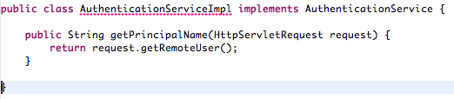
Authentication Service
Fairly Simple
Provides a hook if additional processing needs to be done
  E.g., if the principal name returned by the authentication layer needs to be converted to what is in KIM’s tables.
Notes:
often a servlet filter
doesn't do much more than provide a principal name

Slide 7
Identity (Entity) Service
Everything to do with a person
Can be hooked up to an existing user directory
Notes:
doesn't just have to be a person
will go into Entities later

Slide 8
Entities/Principals
Represents a single person/vendor/system
Entity Types
Entities Have:
  Principals
  Names
  Employment Information
  more...
Entity Types Have:
  Addresses
  Phone Numbers
  Email Addresses
  more...

Slide 9
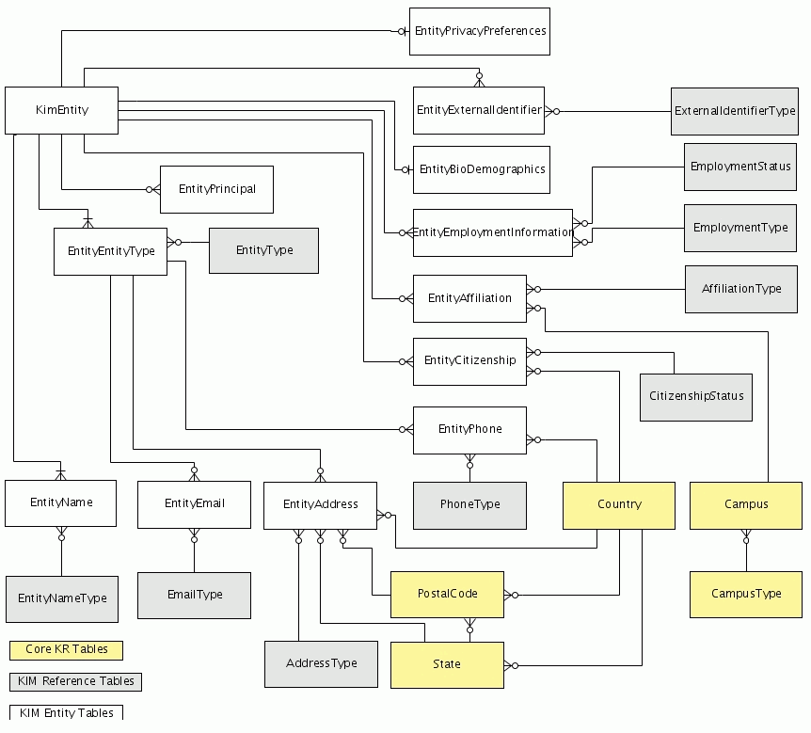
Entity Data Model
Notes:
note affiliation reference

Slide 10
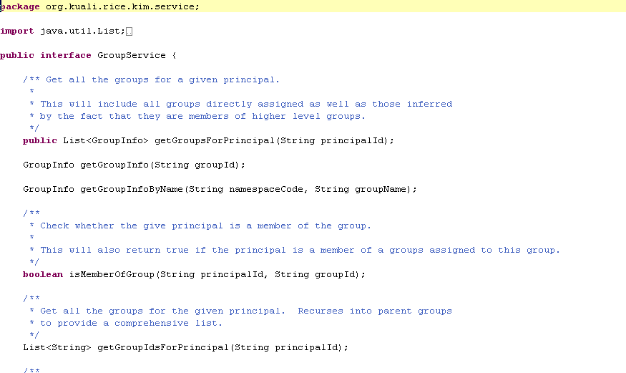
Group Service
General-purpose groups of users
Again, this may be attached to an external system

Slide 11
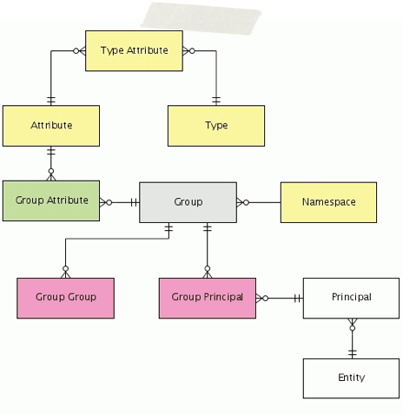
Groups
Simple holders for principals and other groups
Types
Attributes
Services
Notes:
types define the attributes which may be used on a group
services can validate the attributes
define the document type used for routing changes to a group of that type

Slide 12
Permissions / Responsibilities
Permission: Something you can do within an application
  Used for granting access
Responsibility: Something you must do
  Used by workflow
  Additional data specifies the type of action required
Notes:
Need to give examples
roles for approvers
example of fiscal officer
editability of fields during routing
requirement to approve

Slide 13
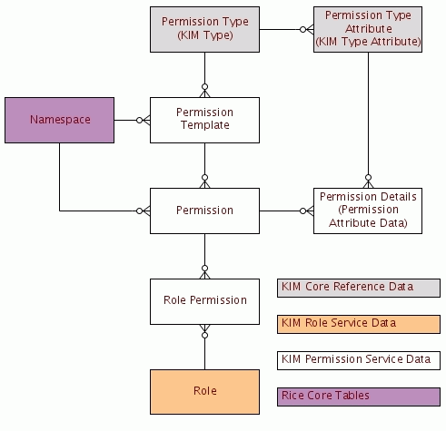
Permission Data Model
Notes:
Need to give examples
roles for approvers
example of fiscal officer
editability of fields during routing
requirement to approve

Slide 14
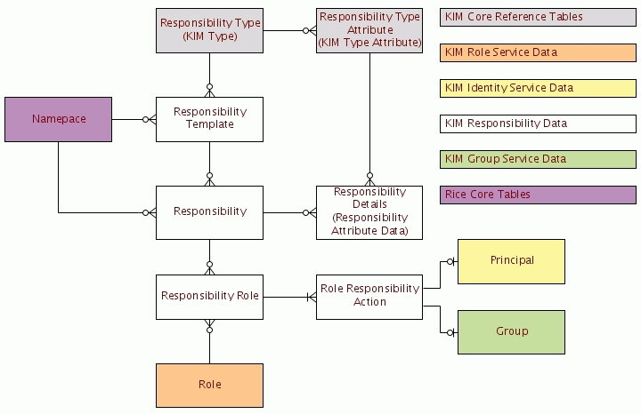
Responsibility Data Model
Notes:
Need to give examples
roles for approvers
example of fiscal officer
editability of fields during routing
requirement to approve

Slide 15
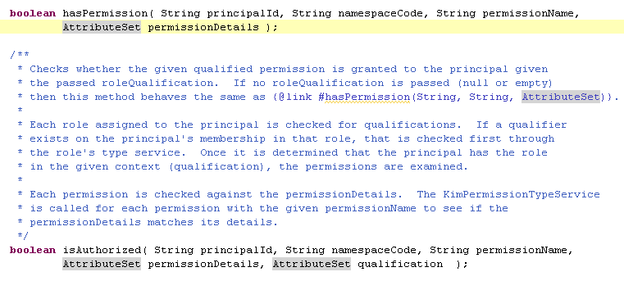
Permission/
Responsibility Services
Permission Service
  Core service to check whether a person has a permission
  Communicates with the role and group services
Responsibility Service
  Used by workflow to find people who need to take an action on a document
Notes:
describe difference between hasPermission and isAuthorized

Slide 16
Roles
Like Groups, but more...
Permissions
Responsibilities
Delegations
Qualifications?!?
Notes:
Roles can contain principals, groups, and other roles
roles may be associated with permissions and responsibilities
Roles can be nested (slightly different from role membership)
Membership in a role can be delegates - more later

Slide 17
Role Service
Mostly an internal service
Handles checking and listing role memberships
Resolves role membership qualifications via service calls
Notes:
Roles are not known outside of the IdM service
Permission and Resp. service communicate with it directly
Probably one of the easiest to remote

Slide 18
Role Types/Qualified Roles
Membership in a group may be qualified
Qualifiers are defined by the role type
Qualifier matching handled by the role type service
  Allows client application knowledge/data to be applied
  ex: org structure
Application Roles
  Roles where membership is not stored in KIM but is derived or stored in a client application.
    E.g., Fiscal Officer in KFS: For a given qualifier set of chart and account, the role will have a single principal who is stored on the KFS account table.
Notes:
application roles - dynamic roles - membership can be determined by the qualifiers
e.g. - fiscal officer - application role - service looks to KFS to get the principal ID off the main account table in KFS

Slide 19
Delegations
Delegations are another type of role member
Are delegations of the role, not of one person to another
Delegates may be principals, groups, or other roles
Delegations are not nested
Notes:
on nature of delegation:
you would set up a delegation
Travel Approver (role) for the Math department
I would add a delegation for this role - qualifying the delegation by the organization (Math) and (optionally) a date range and/or dollar limit ($500)
This allows the delegations to persist when the primarys (of which there could be more than one) change.
If no primary - delegates not scanned

Slide 20
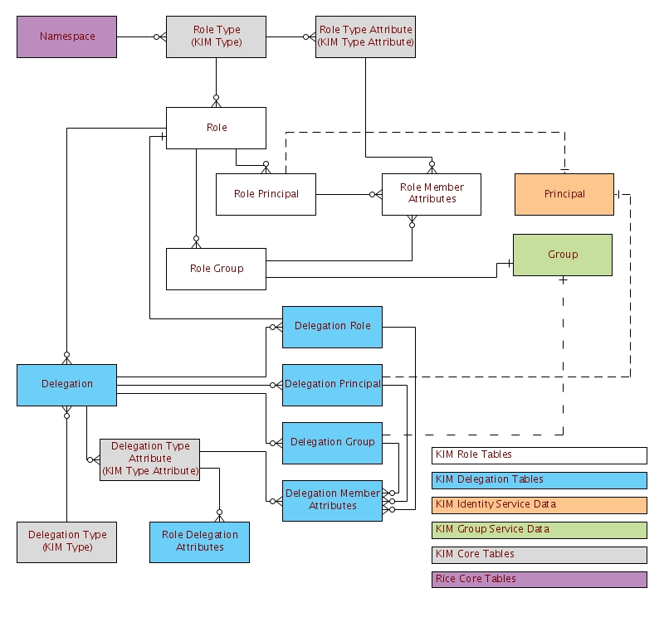
Role Data Model
Notes:
role role

Slide 21
Interaction with KNS
Identity Management Service
  Caching of core services
  Runs locally within the client application
Person / Person Service
  Abstraction of Entities and Principals
KNS Authorization Service
  Partial abstraction of the IdentityManagementService
Notes:
IdM service has configurable caching of

Slide 22
Uses of KIM in the KNS
Controlling User Login
Document initiation Control
Field-level authorizations in maintenance documents
  hidden/read-only/masking
Editing of parts of documents during routing
Responsibility-based Routing
  Mandatory Review
  Voluntary Review

Slide 23
Questions?

